Slide 1
Philips MRI spiral reconstruction problem
By Emiel Hartsema
ehartsema@student.tudelft.nl

Slide 2
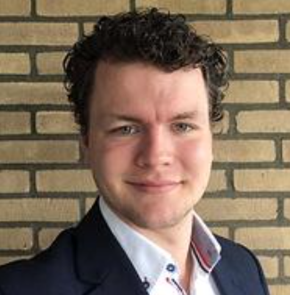
Emiel Hartsema
Master project applied physics TU Delft
Working on advanced reconstruction algorithm for multicomponent magnetic fingerprinting
Email: K.E.Hartsema@student.tudelft.nl

Slide 3
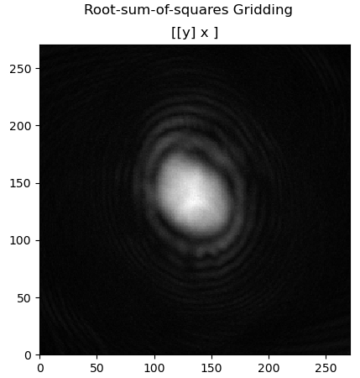
Reconstruction algorithm
To test, I made a simple reonstruction algorithm, same as shown in sigpy turotial [1]
Should be a brain image
[1] https://github.com/mikgroup/sigpy-mri-tutorial/blob/master/01-gridding-reconstruction.ipynb

Slide 4
Reading kspace data
Data read from datafile with matlab script
Output format is as expected (i.e. correct num of coils, num images, num datapoints per spiral, num spirals per image)
Python version gives exactly same resulting complex matrix
Reading kspace data does not seem to be the problem

Slide 5
Generating kspace coordinates
Parameters used (as given in settings file)
FOV: 224 mm
spirals per image = 32;
acq. window (ms) = 6.5;
spiral direction = "spiral out";
variable density =not specified in this scan (assumed “no”)
Sampling tau calculated from acq window and #samples (1864).
6.5/1864 = 0.00348712
Oversampling ratio = 1
Spiral variable frequency scale – CSC parameter = 3.0

Slide 6
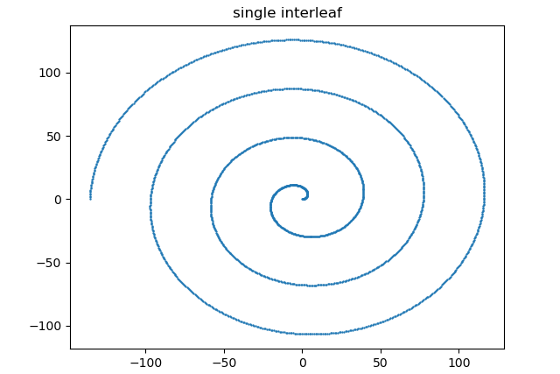
Generating kspace coordinates
Interleaf generated with spiralblur2018.py
Interleafs are rotated 2pi/32 * ky (counter clock wise)
ky from the .list file [0,1,2,…,31]
First interleaf starts in +x direction

Slide 7
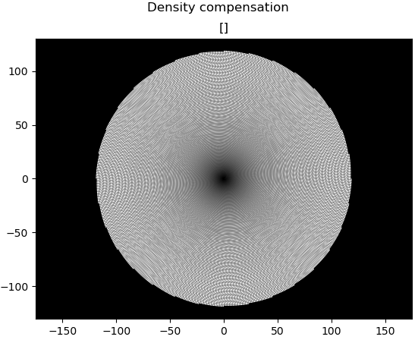
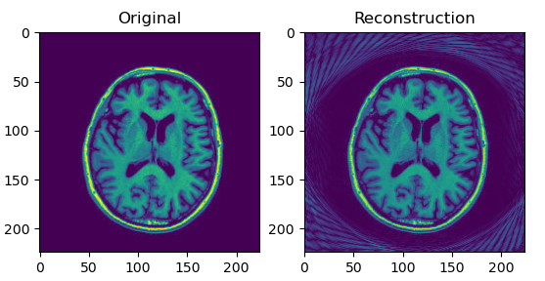
Density compensation
Density compensation based on a paper linked below
Hoge, R. D., Kwan, R. K. S., & Pike, G. B. (1997). Density compensation functions for spiral MRI. Magnetic Resonance in Medicine, 38(1), 117–128. https://doi.org/10.1002/mrm.1910380117

Slide 10
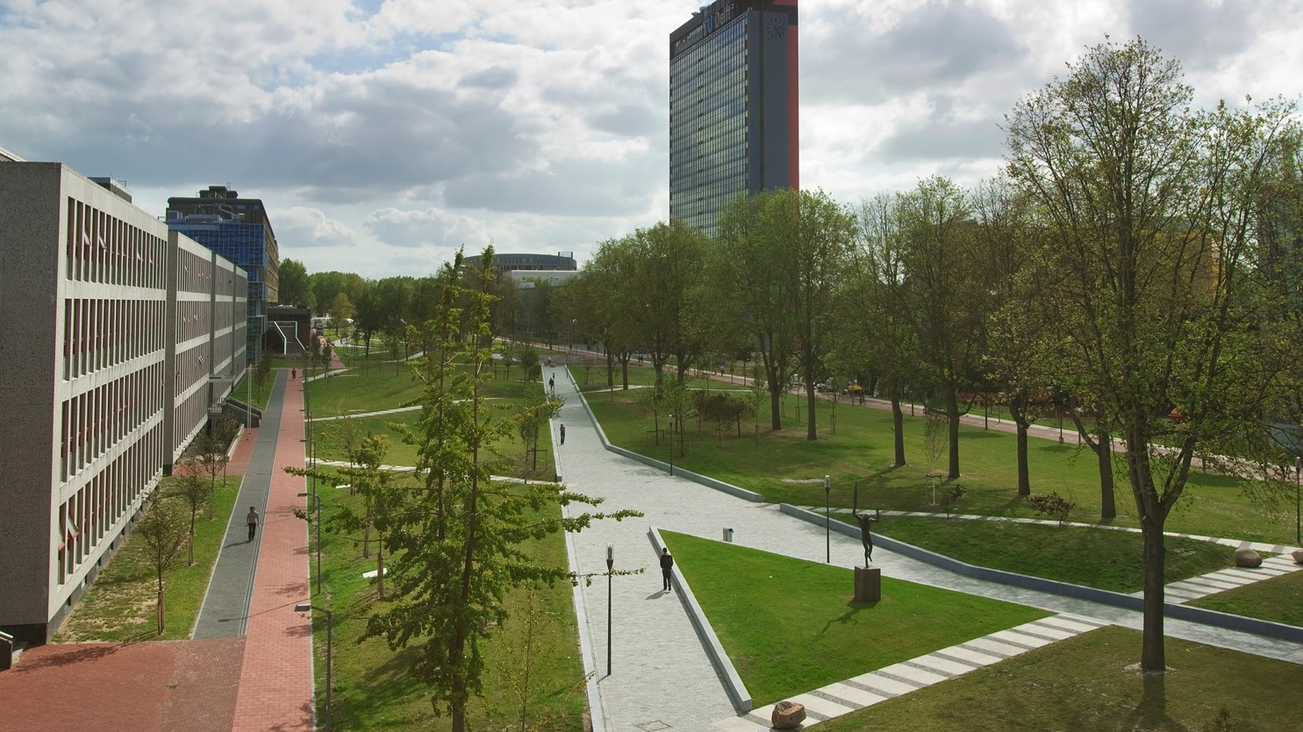
Insert a picture

Slide 11
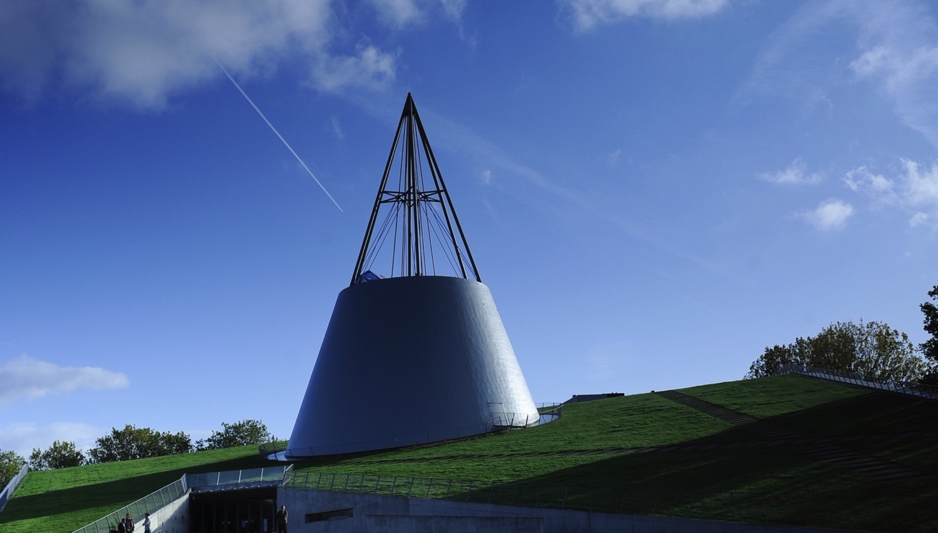
Insert a picture

